Slide 1
Deep Learning: Tensorflow and CNNs
By: Satyen S.

Slide 2
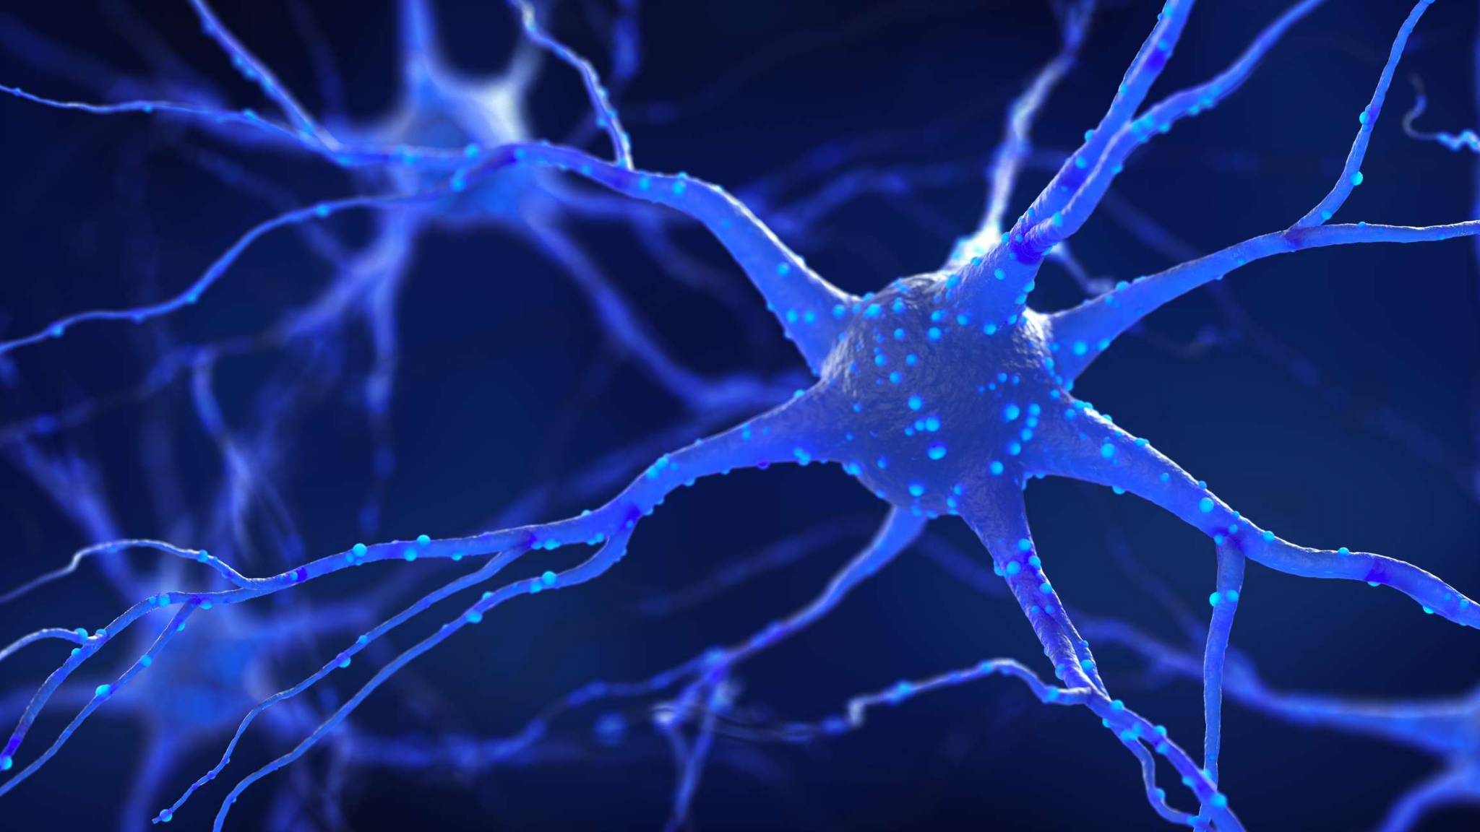
Recap: Perceptrons
Which of the following is NOT a function of a perceptron?
Apply an activation function
Scale inputs by weights
Add a bias
Scale output

Slide 3

Recap: Activation Functions
What is the primary goal of an activation function?
Combat linearity
Strengthen feature correlations
Deter overfitting
Minimize error

Slide 4

Recap: Neural Network Hyperparameters
Which of the following describes the function of a model’s learning rate?
Determine which weights will be modified
Determine by how much weights will be modified
Determine how often weights will be modified
Determine proportion of weights to be modified

Slide 5
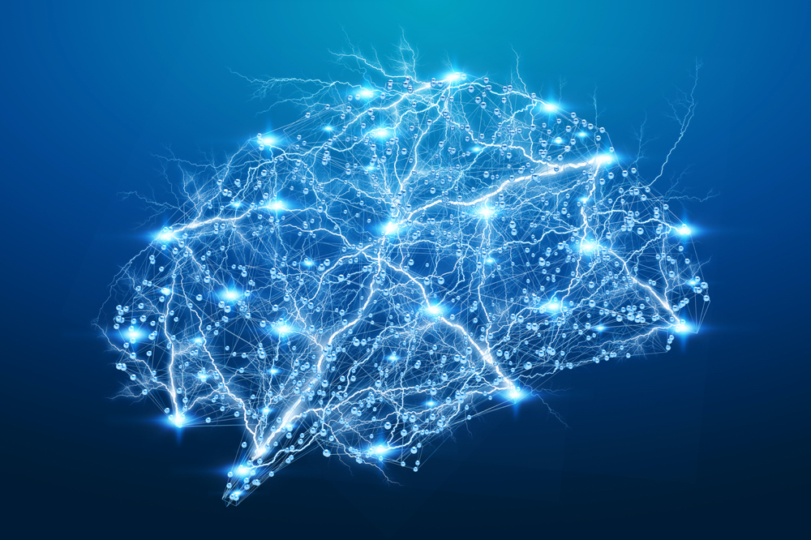
Recap: Neural Network Hyperparameters
Which of the following describes the function of a model’s optimizer?
Determine which weights will be modified
Determine by how much weights will be modified
Determine how often weights will be modified
Determine proportion of weights to be modified

Slide 6
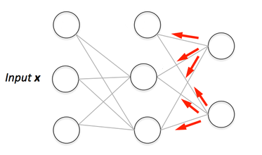
Forward Propagation and Backpropagation
Forward Propagation: Refers to moving input through the model
Backpropagation: Refers to moving through the model and adjusting weights
Can further tune backpropagation with hyperparameters

Slide 7
Recap: Neural Network Hyperparameters
Which of the following would most directly lead to a higher chance of overfitting?
Large # Epochs, Small batch size, Small Learning Rate
Small # Epochs, Small batch size, Large Learning Rate
Large # Epochs, Large batch size, Large Learning Rate
Small # Epochs, Large batch size, Small Learning Rate

Slide 8
Neural Network Demo!
Completed: https://colab.research.google.com/drive/18T0K_jVJkVfUQiaUKn0U7uGxUCqiLOGs?usp=sharing

Slide 9
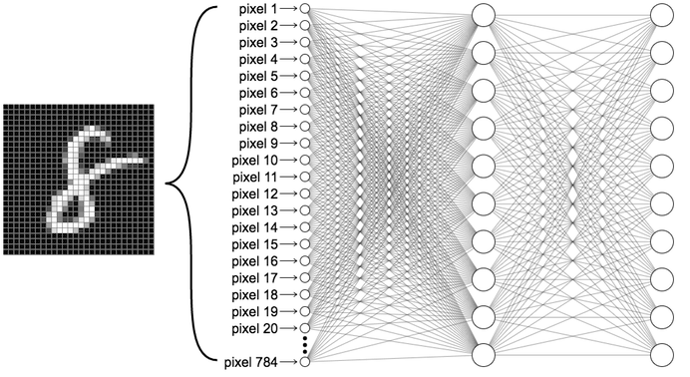
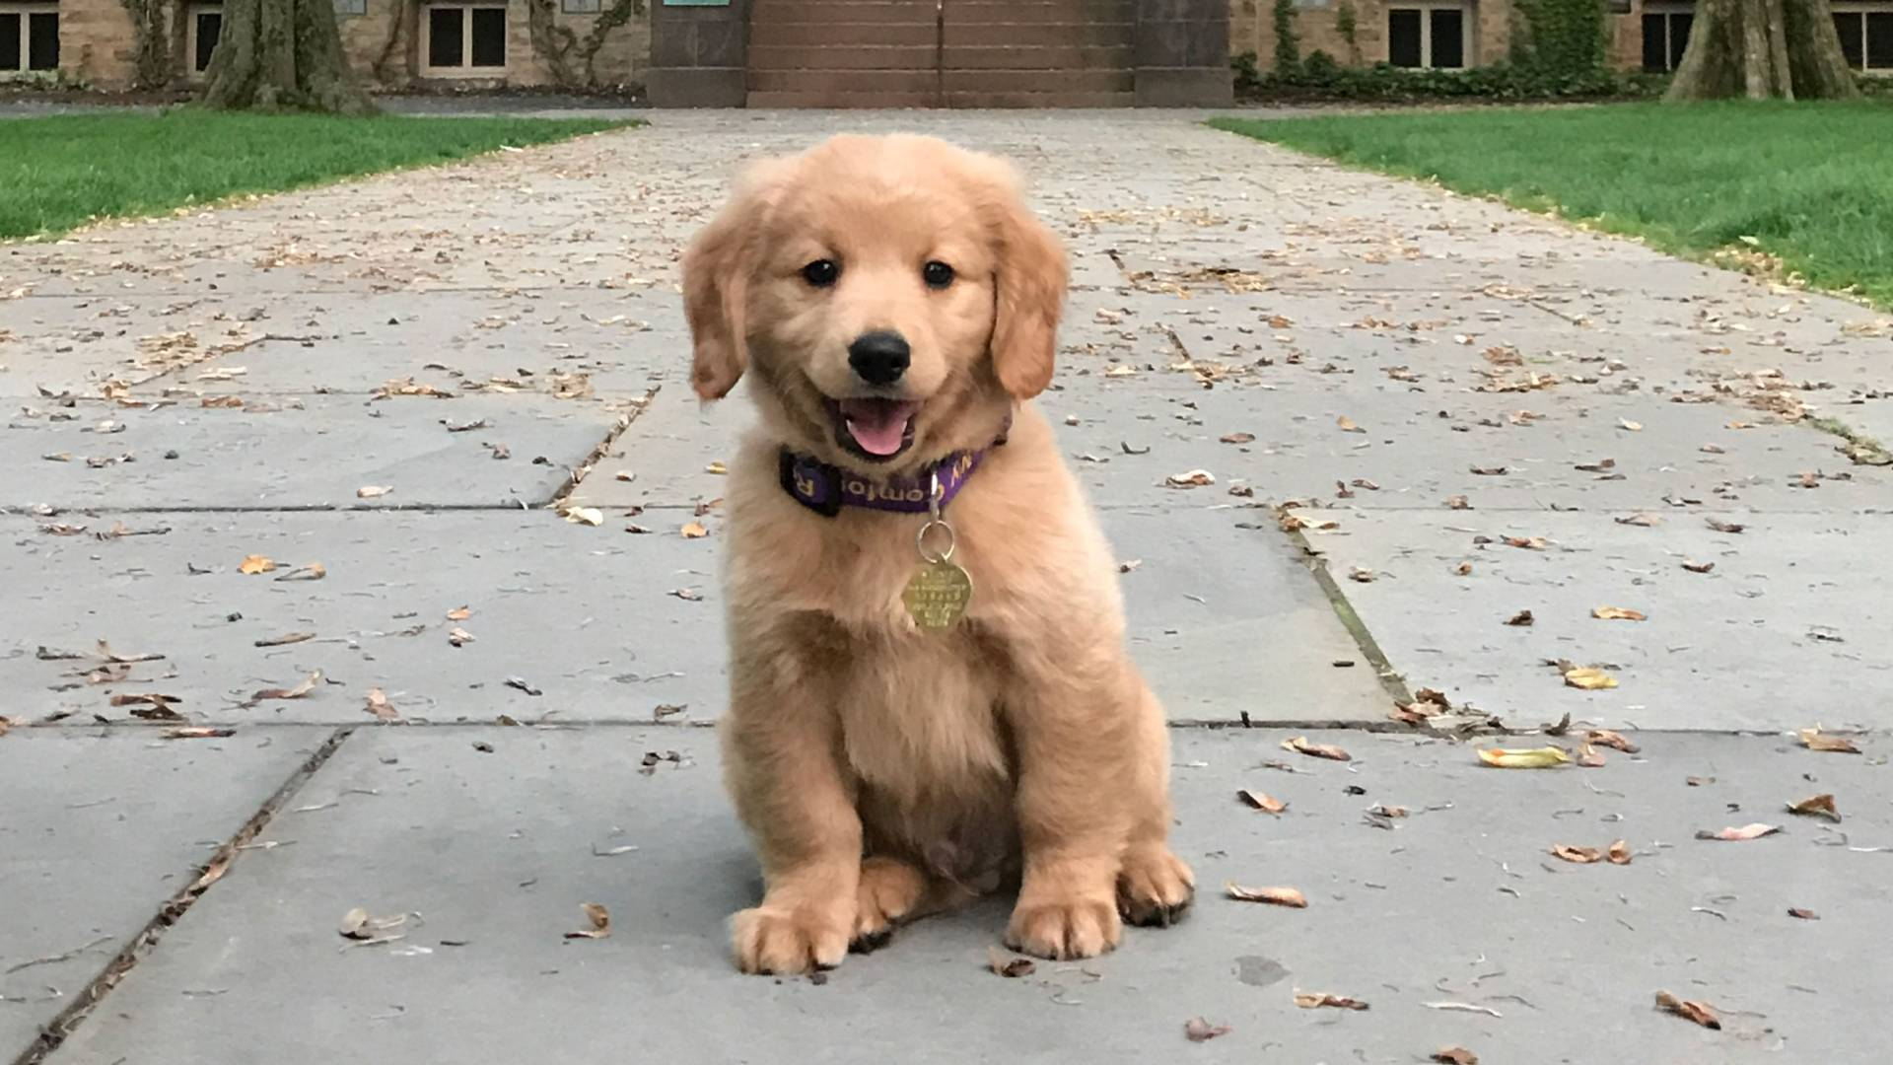
FFNN: Image Classification
Generic FFNNs can perform (image) classification
Struggle with very large images/videos
Many weights
Backpropagation is very slow and expensive
Feature detection can be localized
Prediction: Dog
Prediction: Sidewalk

Slide 10

Convolutional Neural Network (CNN): Motivation
Combats feature localization with sparse connections between layers (NOT fully connected)
Combats translation by convolving over entire input with SAME weights (known as a filter)
Comprised of various layer types (Convolution, Relu, Pooling, etc.)

Slide 11

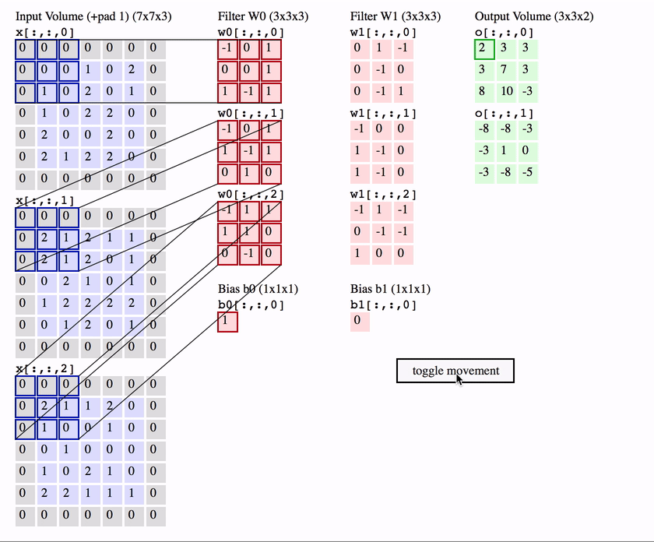
CNN: Convolutional Layers
Map a filter over an input to produce a feature map
The filter moves with a stride
Feature map size will differ from input size
If input is in color (or otherwise has depth), filter will be volume (3D) but still produces a scalar output per each convolution
Often layer will have multiple filters to produce
multi dimensional output

Slide 12
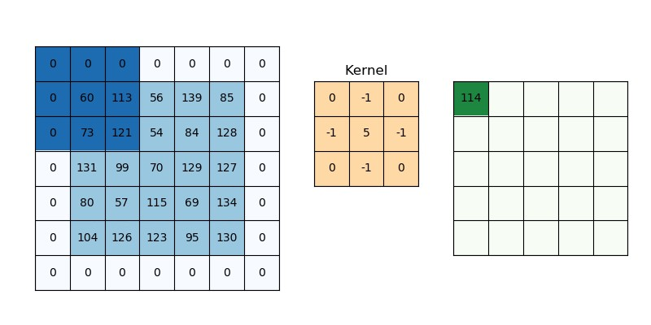
CNN: Zero Padding
Often performed on input to convolutional layer
Allows filter to operate on edges of image
Allows us to produce a feature map of particular size (often we keep the same size as input)
Q: What would be the stride here?
Q: What is the size of the feature/kernel?

Slide 13

CNN: ReLU Layer
Allows us to ignore irrelevant parts of the image (since activation function kills any negative input)
Makes backpropagation easier for optimizer (due to magnitude of gradient)

Slide 14
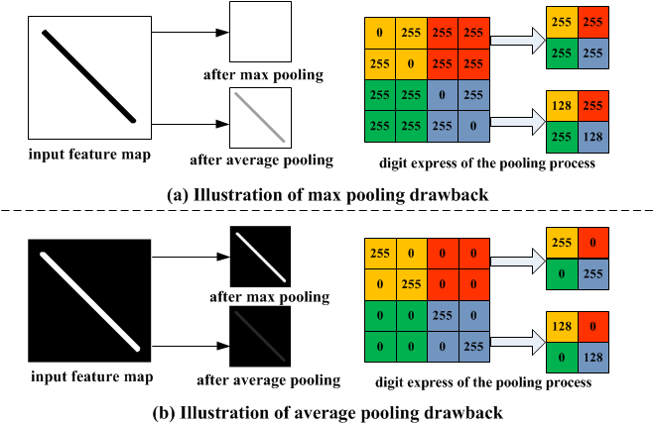
CNN: Pooling
Intuition:
Convolutional neural networks are VERY intensive - help mitigate computations
Combat overfitting
Pooling allows us to decrease the dimensionality of input (see WK 3)
Generally max pooling more useful
Can have overlapping pooling
Pooling filter size
Pooling stride size

Slide 15

CNN: Fully Connected Layers
Model ends by feeding into FNN
Input from Conv/Pooling is flattened
Final output layer has activation function
Returns a vector of probabilities for each output class

Slide 16
CNN Demo!
Completed: https://colab.research.google.com/drive/17o12uw9Vz4Q-G8YMsdF9Crn2OOvZYcNQ?usp=sharing
(Source from: https://www.tensorflow.org/tutorials/keras/classification)

Slide 17
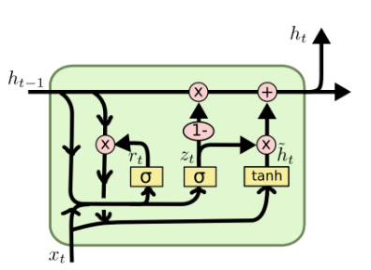
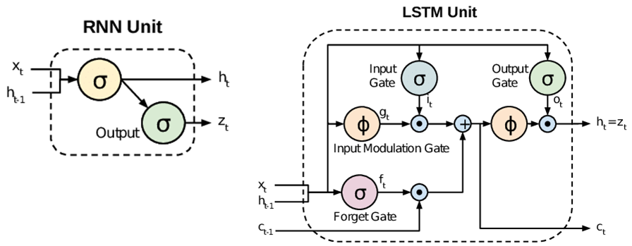
Looking Forward: Model Types and Optimization
Other types of Neural Networks
Optimizing models
Bigquery native models
Notes:
Neural Networks: for next time

